Slide 1
DAW using LabVIEW

Slide 2
CONTENTS
Introduction
Working
Results
Conclusion

Slide 3
INTRODUCTION
Digital Audio Workstations (DAW) are software program used for composing, producing, recording, mixing, and editing audios like music, speech, radio, podcasts and nearly any other situation where complex recorded audio is needed and MIDI.
We try to build a simpler version of this software using LabVIEW
Audios are recorded, edited, mixed, mastered on DAWs.
This project requires the use of an Electric Violin and an audio interface to record live audio to LabVIEW

Slide 4
Sounds from the Violin are fed to the audio interface which converts it to digital format which are fed into the computer and stored.
We record multiple sounds and try to mix them into one single audio file.
We merge two WAV files and write it into a single WAV.
Sounds in real-time are Analog in nature, which computers cannot process and store.
To store the data in computers, it must be in digital format.

Slide 5
WORKING
The audio format used is WAV. WAV format is considered to have the highest quality of audio.
. Under Sounds palette in the Graphics and Sounds section, we can find an Express VI called Acquire Sound. This VI directly takes in sound from an input.
The input audio is then plotted on a Waveform Chart to visualize the audio.
We use Merge Signals Function to mix the 2 audios.
Merges two or more signals, such as scalar numeric, 1D or 2D arrays of numeric, scalar Booleans, 1D or 2D arrays of Booleans, waveforms, or 1D arrays of waveforms, into a single output.
Music also being a signal, we have used this Merge Signals Function.
Acquires data from a sound device. This Express VI automatically configures an input task, acquires the audio data, and clears the task after the acquisition completes.

Slide 6
Sound File Read Simple reads data from a .wav file into an array of waveforms from the path specified.
Sound File Write Simple writes the recorded audio to a .wav file in the path specified.
The duration is manually set in this project to 17 secs.
The input source is selected from the list of inputs automatically shown.
List of inputs vary according to the type of input used.
Here, we use an Evo Audio Interface, and we select the input as 2 which refers to Violin.
The path for the mixed audio to store is given manually. The audio file we use as the secondary audio is D#.wav.
This audio file is perfectly mixed with the recorded audio sample from the Electric Violin and is stored in the path provided as test1.wav on Desktop.

Slide 7
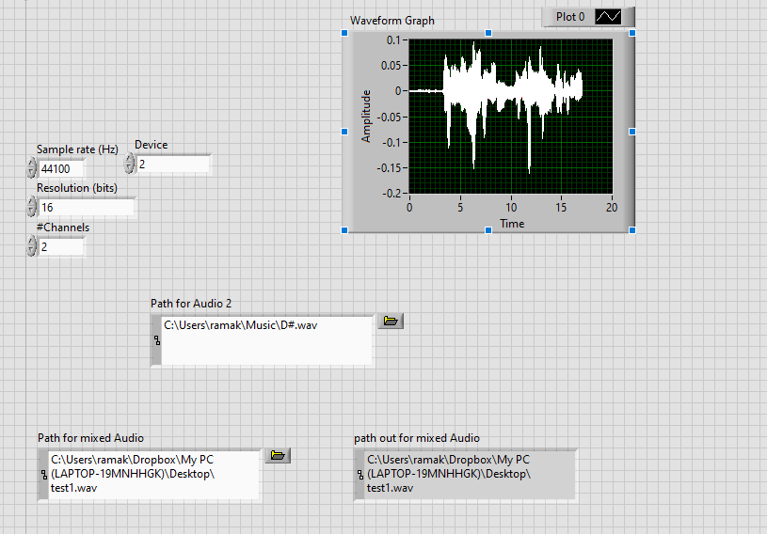
RESULTS
This is the Front Panel View of the LabVIEW.
The path for secondary audio and the mixed audio is given.
The recorded audio is visualized on a Waveform Graph.
The Sampling Rate, Resolution are set according to the type of Audio Interface used

Slide 8
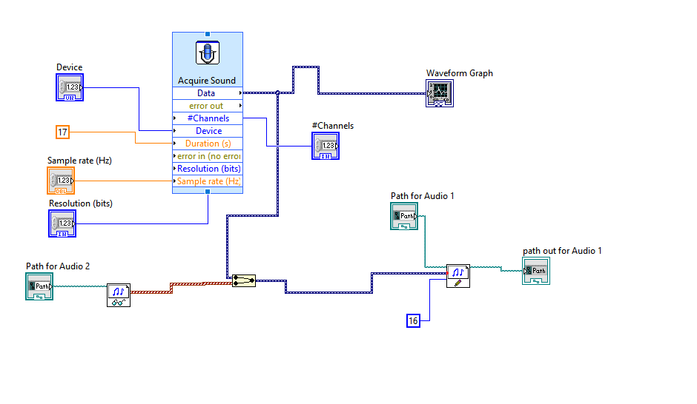
The Acquire Sound VI used here to acquire sounds from an audio input device.
Visualized on a Waveform Graph.
Sound File Read Simple VI used to read a wav file from the path specified
D#.wav is the file which is read
Sound File Write Simple is used to write the recorded audio to a wav file in the path specified
test1.wav is the file to which we write

Slide 9


